Slide 1
Sorting and Searching

Slide 2
Goals
To study several sorting and searching algorithms
To demonstrate that algorithms for the same task can differ widely in performance
To study the big-Oh notation
To learn how to estimate and compare the performance of algorithms
To learn how to measure the running time of a program

Slide 3
Analyzing Algorithms
Algorithm Analysis can involve consideration of:
  Computing time
  Storage requirements (space)
Performance evaluation is divided into 2 major approaches:
  a priori estimates – eg: O() notation
  a posteriori testing - empirical observation of runtime differentials; machine specific.

Slide 4
Sorting
Internal:
the amount of data to be sorted is small enough to fit in RAM
External:
not all data fits in RAM at the same time
Categories/classification of sorting algorithms are based on 2 basic operations:
  — comparing two elements
  — moving an element from one place to another
Simple sorts: O( n² )
Advanced sorts: O(n lg n)
Radix sort: O(k x n)

Slide 5

Selection Sort
Sorts an array by repeatedly finding the smallest element of the unsorted tail region and moving it to the front
Slow when run on large data sets
Example: sorting an array of integers

Slide 6
Implementation in Java
public void selectionsort(Object[] data) {
int i, j, least;
for (i = 0; i < data.length-1; i++) {
least = i;
for (j = i+1; j < data.length; j++)
if ((data[j]).compareTo(data[least])<0)
least = j;
if (least != i)
swap(data,least,i);
}
}
Different version:
H:\AdvCompProg\SourceCode\01sortSearch\selectionSort\

Slide 7
Profiling the Selection Sort Algorithm
Outer loop: n - 1 times
Inner loop: (n -1) + (n - 2) + … + 1 = n (n-1) / 2
compares: O(n²)
moves: O (n )
-- independent of initial data arrangement

Slide 8
Profiling the Selection Sort Algorithm
Create a StopWatch object
  Start the stopwatch just before the sort
  Stop the stopwatch just after the sort
  Read the elapsed time

Slide 9
Selection Sort on Various Size Arrays*
n | Milliseconds
10,000 | 772
20,000 | 3,051
30,000 | 6,846
40,000 | 12,188
50,000 | 19,015
60,000 | 27,359
*Obtained some years ago with older technology …
H:\AdvCompProg\SourceCode\01sortSearch\selsort\SelectionSortTimer.java

Slide 10
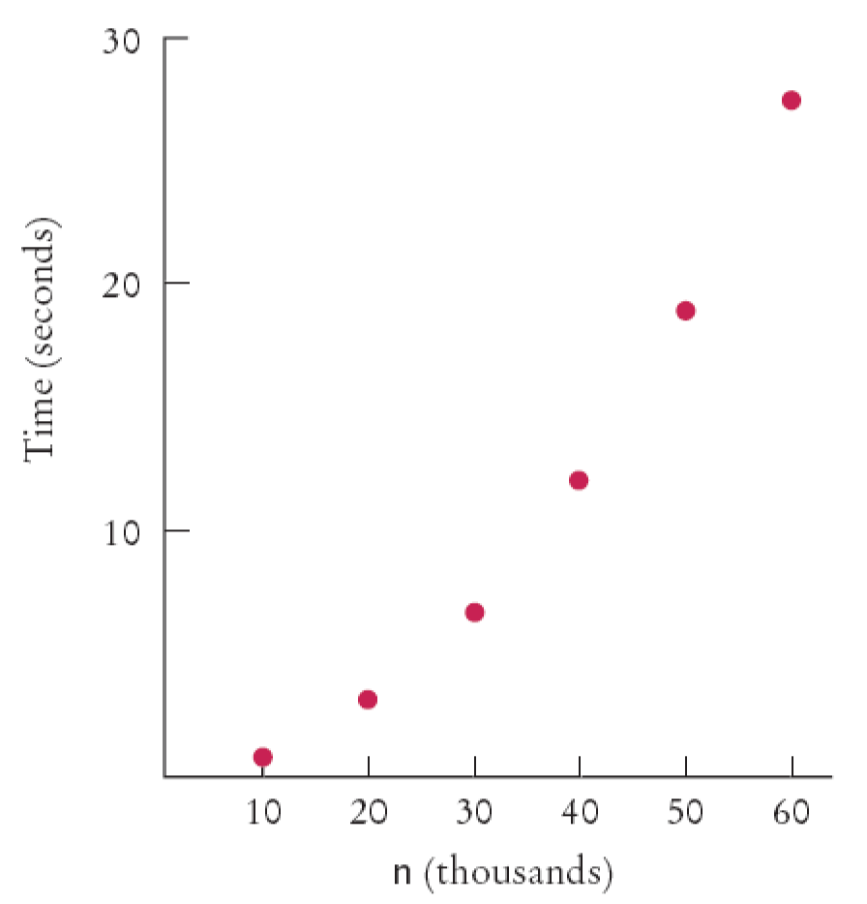
Selection Sort on Various Size Arrays
Doubling the size of the array more than doubles the time needed to sort it .
Time Taken by Selection Sort

Slide 11
Analyzing the Performance of the Selection Sort Algorithm
The number of visits is of the order n²
Using big-Oh notation: The number of visits is: O(n²)
Multiplying the number of elements in an array by 2 multiplies the processing time by 4
Big-Oh notation "f(n) = O(g(n))"
expresses that f(n) grows no faster than g(n)
To convert to big-Oh notation: locate fastest-growing term, and ignore constant coefficient

Slide 12
Insertion Sort
basic operation: insertion of a single element into a sequence of sorted elements so the resulting sequence is still sorted
scan the elements below the element to be inserted; each element that is large compared to the element to be inserted is moved up one position; if an element is found that is small compared to the element to be inserted, the scan terminates and insertion occurs ahead of the small element.

Slide 13
Insertion Sort
Pos.
Initial
0..1
0..2
0..3
0..4
0..5
0 | 1 | 2 | 3 | 4 | 5
8 | 5 | 9 | 2 | 6 | 3
5 | 8 | 9 | 2 | 6 | 3
5 | 8 | 9 | 2 | 6 | 3
2 | 5 | 8 | 9 | 6 | 3
2 | 5 | 6 | 8 | 9 | 3
2 | 3 | 5 | 6 | 8 | 9
Sorted items

Slide 14
Insertion Sort
public void insertionsort(Object[] data) {
for (int i = 1; i < data.length; i++) {
Comparable tmp = (Comparable)data[i];
for (int j = i; j>0 && tmp.compareTo(data[j-1])<0; j--)
data[j] = data[j-1];
data[j] = tmp;
}
}

Slide 15
Merge Sort
Basic Algorithm:
Cut the array in half (a Divide and Conquer algorithm)
Recursively call sort for each half until down to one item
Merge the sorted items into increasingly large lists

Slide 16
Merge Sort Example
Divide an array in half until one item
merge increasingly large lists upon return:
  54 27 68 23 55 32 87 65
  27 54 23 68 32 55 65 87
  23 27 54 68 32 55 65 87
  27 32 54 55 65 68 87
H:\AdvCompProg\SourceCode\01sortSearch\mergesort\mergesortDemo

Slide 17
Analyzing the Merge Sort Algorithm
n | Merge Sort (milliseconds) | Selection Sort (milliseconds)
10,000 | 31 | 772
20,000 | 47 | 3,051
30,000 | 62 | 6,846
40,000 | 80 | 12,188
50,000 | 97 | 19,015
60,000 | 113 | 27,359

Slide 18
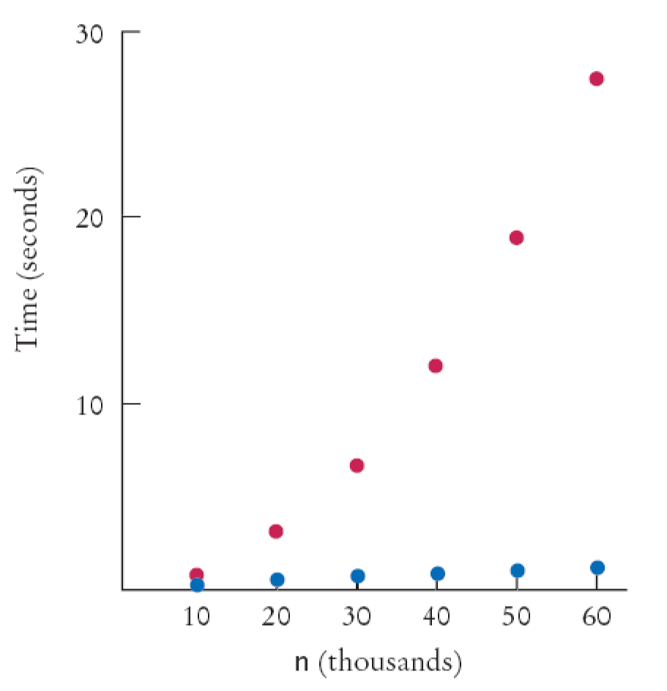
Merge Sort Timing vs. Selection Sort
Merge Sort Timing (blue) versus Selection Sort (red)

Slide 19
Analyzing the Merge Sort Algorithm
Use a recurrence from discrete mathematics:
1 for n = 1
2T(n/2) + n for n > 1
What is the complexity of: T(n) = 2T(n/2) + n
Let's use a recurrence tree . . .
{
T(n) =

Slide 20
Merge Sort vs Selection Sort
Selection sort is an O(n²) algorithm
Merge sort is an O(nlog(n)) algorithm
The nlog(n) function grows much more slowly than n²

Slide 21
Sorting in a Java Program
The Arrays class implements a sorting method
To sort an array of integers
That sort method uses the Quicksort algorithm
int[] a = . . . ;
Arrays.sort(a);

Slide 22
The Quicksort Algorithm
Another divide and conquer algorithm
Input elements:
r[0], r[1], … , r[n-1]
Result of a step:
r[0], r[1], …, r[j-1] r[j] r[j+1], r[j+2], … r[n-1]
List of
elements < r[j], remains to be sorted
List of
elements > r[j], remains to be sorted
Element in its final position

Slide 23
The Quicksort Algorithm
Consider this list:
40 15 30 25 60 10 75 45 65 35
The leftmost (or rightmost) number is the "pivot."
Partitioning takes place by scanning from the left and right, comparing numbers to the pivot, and swapping
Example . . .

Slide 24
One more thing. . . an O(n) Sort!
Radix Sort
  Used with linked lists
  Runs in O(k * N) where k is the number of items in the key
  Relinks into lists starting with the least significant item

Slide 25
Searching
Linear search: also called sequential search
Examines all values in an array until it finds a match or reaches the end of the list
Number of visits for a linear search of an array of n elements:
  The average search visits n/2 elements
  The maximum number of visits is n
A linear search locates a value in an array in O(n) steps

Slide 26
Binary Search
Locates a value in a sorted array by
  Determining whether the value occurs in the first or second half
  Then repeating the search in one of the halves

Slide 27
Binary Search
Count the number of visits to search a sorted array of size n
  We visit one element (the middle element) then search either the left or right subarray
  Thus: T(n) = T(n/2) + 1
Consider the time for n/2:
T(n/2) = T(n/4) + 1
Substituting into the original equation:
T(n) = T(n/4) + 2
This generalizes to: T(n) = T(n/2^{k}) + k

Slide 28
Binary Search
Assume n is a power of 2, n = 2^{m}
where m = log₂(n)
Then: T(n) = 1 + log₂(n)
Binary search is an O(log(n)) algorithm

Slide 29
Searching a Sorted Array in a Program
The Arrays class contains a static binarySearch method
The method returns either
  The index of the element, if element is found
  Or -k - 1 where k is the position before which
  the element should be inserted
int[] a = { 1, 4, 9 };
int v = 7;
int pos = Arrays.binarySearch(a, v);
// Returns -3; v should be inserted before position 2

Slide 30
Sorting Real Data
Arrays.sort sorts objects of classes that
implement Comparable interface
The call a.compareTo(b) returns
  A negative number if a should come before b
  0 if a and b are the same
  A positive number otherwise
public interface Comparable
{
int compareTo(Object otherObject);
}

